Slide 1
PRESENTATION
OCTOBER 29TH

Slide 2
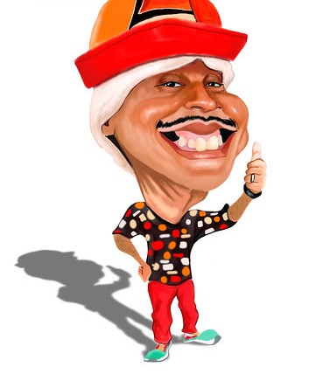
my friend TIRIRICA.

Slide 3

a clown

Slide 4

wakes up at 8:00 A.M

Slide 5

bathroom

Slide 6

breakfast

Slide 7

writing

Slide 8

friends in the square

Slide 9

Stand-up comedy

Slide 10

at 23:00 - 24:00 P.M

